Slide 1
New Tool Type –大量科技FTGM1-100 TAP Development Work Flow (AP)
Notes:
0

Slide 2
1. Data Collection – User – 1. Tool information
Area: 竹南SoIC
Tool ID: HGETM2
Fab: AP06
Vendor name:大量科技
Tool model: FTGM1-100
Tool information (LP, Chamber, Similar Tool, etc.) : 2 Foup L/P, 1 Chamber Similar Tool: HGETM1
Tool release status (T-1, T-2, etc.): T-1 Plan Release Day 12/28 , T-2 Plan Release Day 01/11
Vendor contact information (Name/Phone/Mail):
Software ➔ Name: 陳俊臣 / Phone:0975119081 Mail: ccchen@tlhome.com.tw
Service ➔ Name: Derek /Phone: 0975789030 Mail: derek.lee@tlhome.com.tw
Sales ➔ Name: Eason /Phone: 0932531710 Mail: eason.kao@tlhome.com.tw

Slide 3
1. Data Collection – User – 3. Function list
 | Function |  | Need? (Please tick V) | Need Provide SECS log | SECS | Description
Phase I | ECS |  |  |  | S2F13\S2F14 | Query ECID by ECS
Phase I | PMS |  |  |  | S1F3\S1F4 | Send SVID to PMS
Phase I | ALM | Sent Alarm |  |  | S5F1 | Send alarm to Alarm system
 |  | Pause Tool |  | V | S2F41\S2F42 | For alarm action (停機)
 |  | FDC Alarm |  |  |  | FDC alarm SourceType from EQP to FDC
Phase I | TIDS |  |  | V | S6F11
Phase I | Auto RS |  |  | V | S6F11
Phase I | Auto DC |  |  | V | S6F11 | Report Data to Siview (SPC)
Phase I | Die/Material Pick & Placement |  |  | V | S6F11 | Tool report S6F11 event to host by die pick & place
Phase I | Container ID Gating |  |  | V | S12F73\S12F74 S3F17\S3F18 | S3F17 host provide container ID to tool (not wafer)
Phase I | Die/Material Map Transfer |  |  | V | S12F1\S12F2 S12F3\S12F4 S12F5\S12F6 S12F9\S12F10 S12F15\S12F16 | S12 map download/upload
Phase II | NRMS |  |  | V | S7F5\S7F6 S7F25\S7F26 S7F19\S7F20 S7F3\S7F4 S7F17\S7F18 | Query Binary Recipe Body Query Formatted Recipe Body Query Recipe List Create Binary Recipe Create Formatted Recipe Delete Recipe
 | RMS (Default NRMS. If need, please write reasons.) |  |  | V | S7F5\S7F6 S7F25\S7F26 S7F19\S7F2 | Query Binary Recipe Body Query Formatted Recipe Body Query Recipe List
Phase II | BatchRHLD |  |  | V | S2F41\S2F42 | Batch Hold Reduction
Phase II | Delay Dock |  |  | V |  | Delay Dock Foup
Phase II | Smart Sequence |  |  | V | S7F25\S7F26 S16F15\S16F16 | S7F25 allow host to query available chamber S16F15 allow host to assign non-available chamber

Slide 4
1. Data Collection – User – 4. Test timeline
Please reply to the question and a date for testing of the following items:
Secs initial (測試機台連線) 網路連線是否開通?
Tool mode change (透過 Siview 切換 tool mode) 網路連線是否開通?
Scenario Test:
RFID test E84 sensor 是否安裝?
Auto process
NRMS test (Optional)
FDC defense test (Optional)
Other function (Optional)

Slide 5
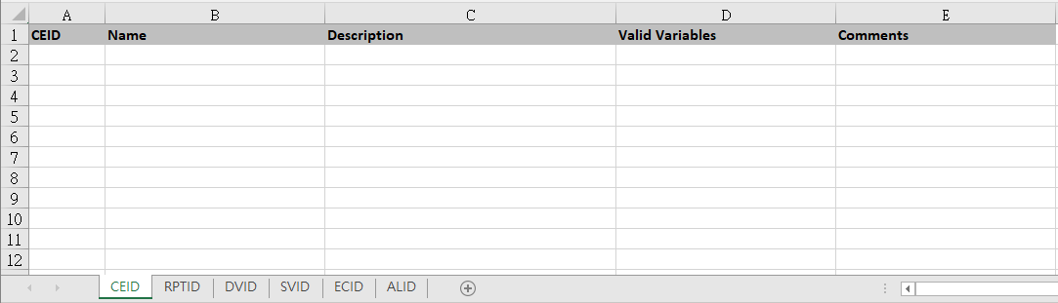
1. Data Collection – Vendor – 3. CEID/RPTID/DVID…
Please refer to template format to provide *.csv or .xlsx file of CEID, RPTID, DVID, SVID, ECID, and ALID list.
Template:

Slide 6
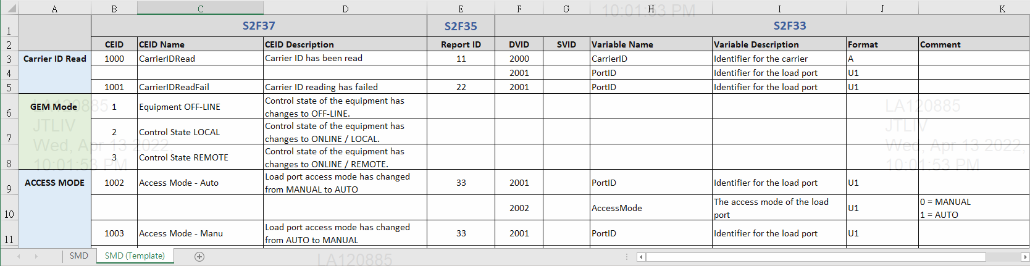
1. Data Collection – Vendor – 4. SMD
Please refer to template format to provide CEID, RPTID, SVID or DVID for S2F33 Define Reports / S2F35 Link Reports / S2F37 Enable Events.
Template:

Slide 7
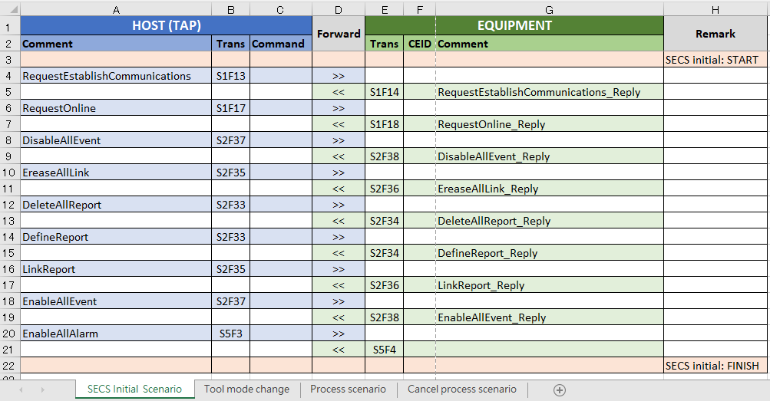
1. Data Collection – Vendor – 5. Flow
Please refer to template format to provide flow by scenario - SECS initial scenario, Tool mode change, Process scenario (include delete residual PJ and CJ), and Cancel process scenario.
Template:

Slide 8
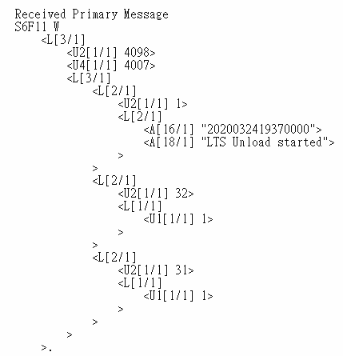
1. Data Collection – Vendor – 6. Simulate log
Please refer to template format to provide simulate log by scenario - SECS initial scenario, Tool mode change, Process scenario (include delete residual PJ and CJ), and Cancel process scenario.
If the function item is ticked in function list , please provide the simulate log of the function.
Template:

Slide 9
Data Collection – Coordinator – Check List
Provider | Data | Done (Please tick V)
User | Tool information
 | Benefit
 | Function list
 | Test timeline
Vendor | Tool introduction | V
 | SECS manual (interface document) | V
 | CEID/RPTID/DVID/SVID/ECID/ALID | V
 | SMD | V
 | Flow | V
 | Simulate log | V

